Slide 1
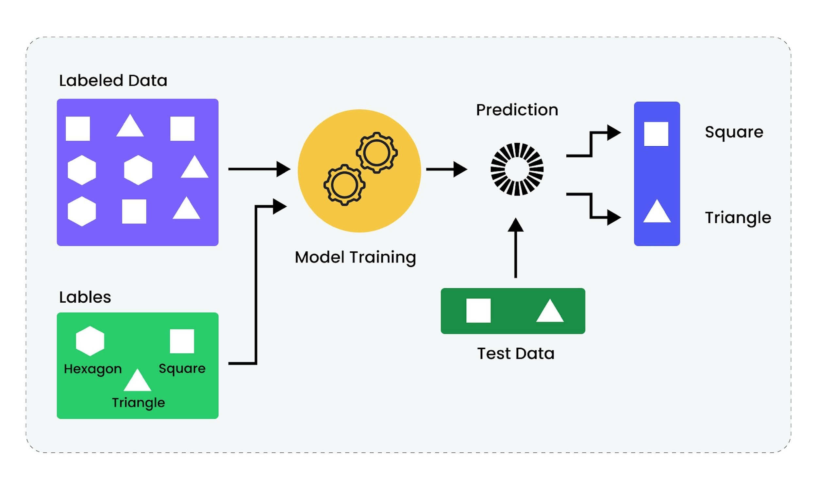
SUPERVISED LEARNING PART 1: CLASSIFICATION
Notes:
<Notes>

Slide 2
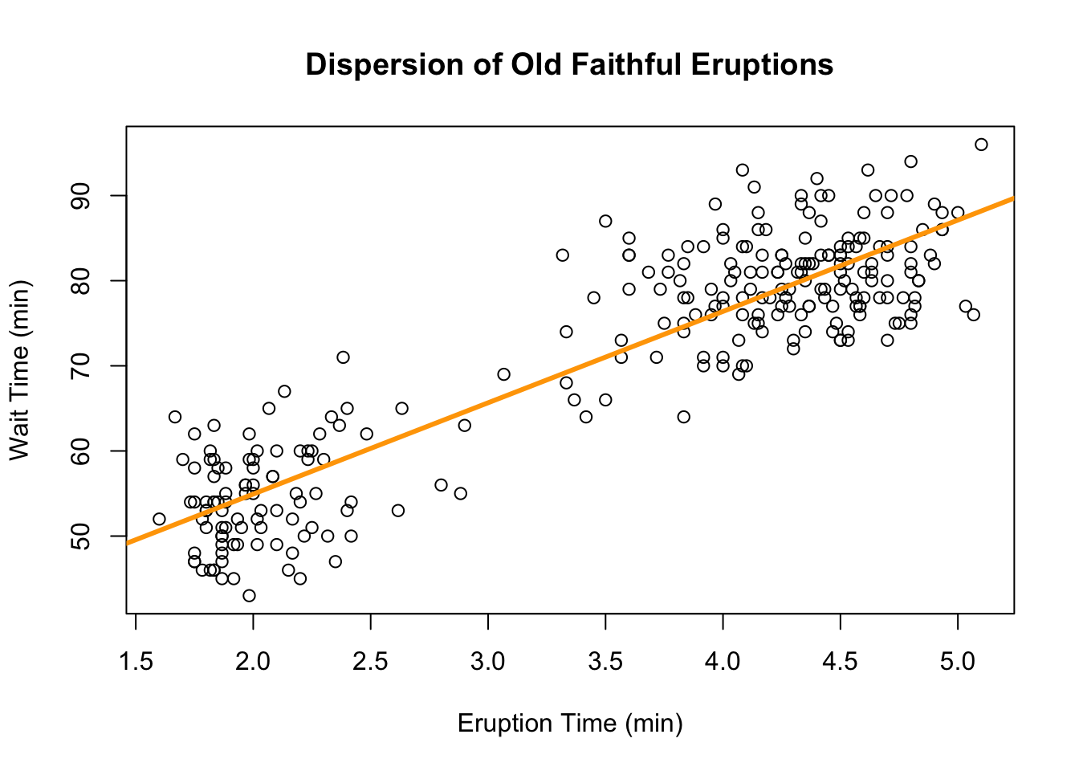
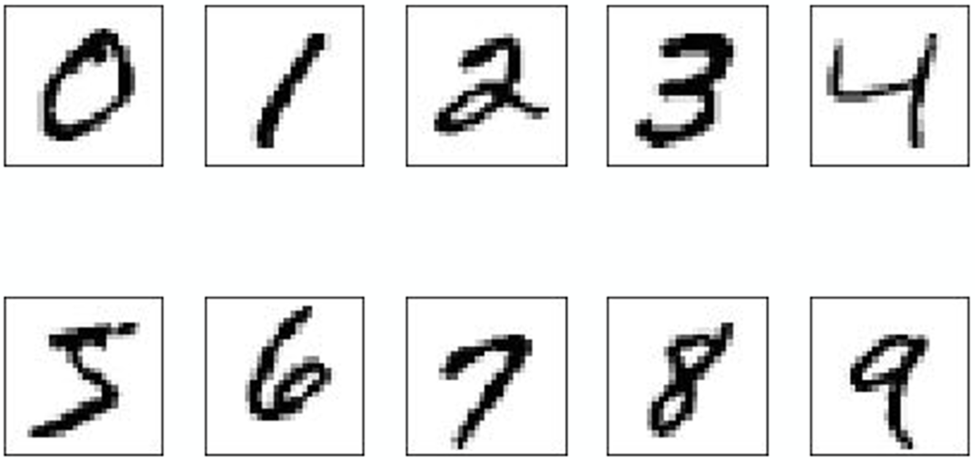
Supervised Learning
Classification
Regression
Predict categories
Validation:
Accuracy (and many more!)
Example: Which digit is it?
Predict continuous values
Validation:
Mean-squared error (more to come)
Example: How long must we wait?

Slide 3
K-Nearest Neighbors (KNN)

Slide 4
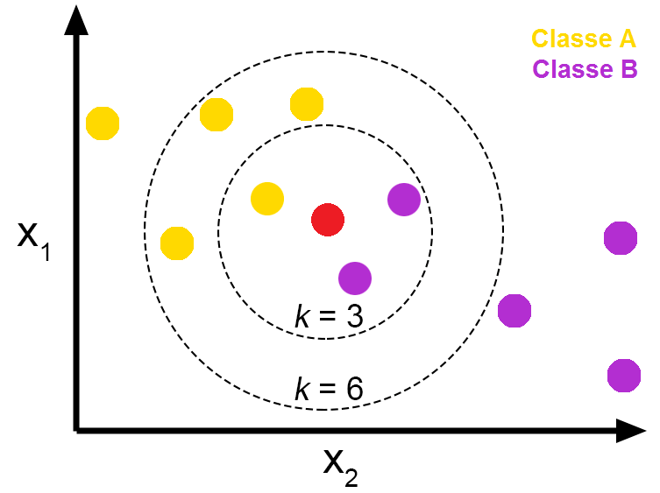
K-NEAREST NEIGHBORS (KNN)
K-Nearest Neighbors (KNN) is a non-parametric, instance-based learning algorithm used for classification and regression
(KNN) algorithm is considered a supervised learning algorithm because it uses labeled training data to make predictions about new, unseen data points.
Main Idea: When given a new data point, KNN looks at the k closest data points in the training set (neighbors) and makes predictions based on their labels.
Instead of building a mathematical model or decision boundary during training, KNN stores the labeled training data.

Slide 5
K-NN Algorithm
Steps:
1. Calculate the distance between the new point and all training points.
2. Sort the distances and find the k nearest neighbors.
3. Predict the label based on the neighbors.
For classification, the majority label among the neighbors is chosen.
For regression, the average of the neighbors’ values is used.

Slide 6
K-NN SUMMARY
Choosing k :
• Small k : Sensitive to noise, can overfit.
• Large k : Smooths boundaries, but may underfit.
Distance Metrics: Common ones are:
• Euclidean Distance (default in Scikit-learn)
• Manhattan Distance
• Minkowski Distance (generalization)
• Cosine Distance (based on angles)
IMPORTANT Scaling Features: Since KNN is distance-based, ensure features are on a similar scale (e.g., use Min-Max Scaling or Standardization).
Advantages:
• Simple to understand and implement.
• No explicit training phase; training data is directly used.
Disadvantages:
• Computationally expensive for large datasets.
• Sensitive to irrelevant features and feature scaling.

Slide 7
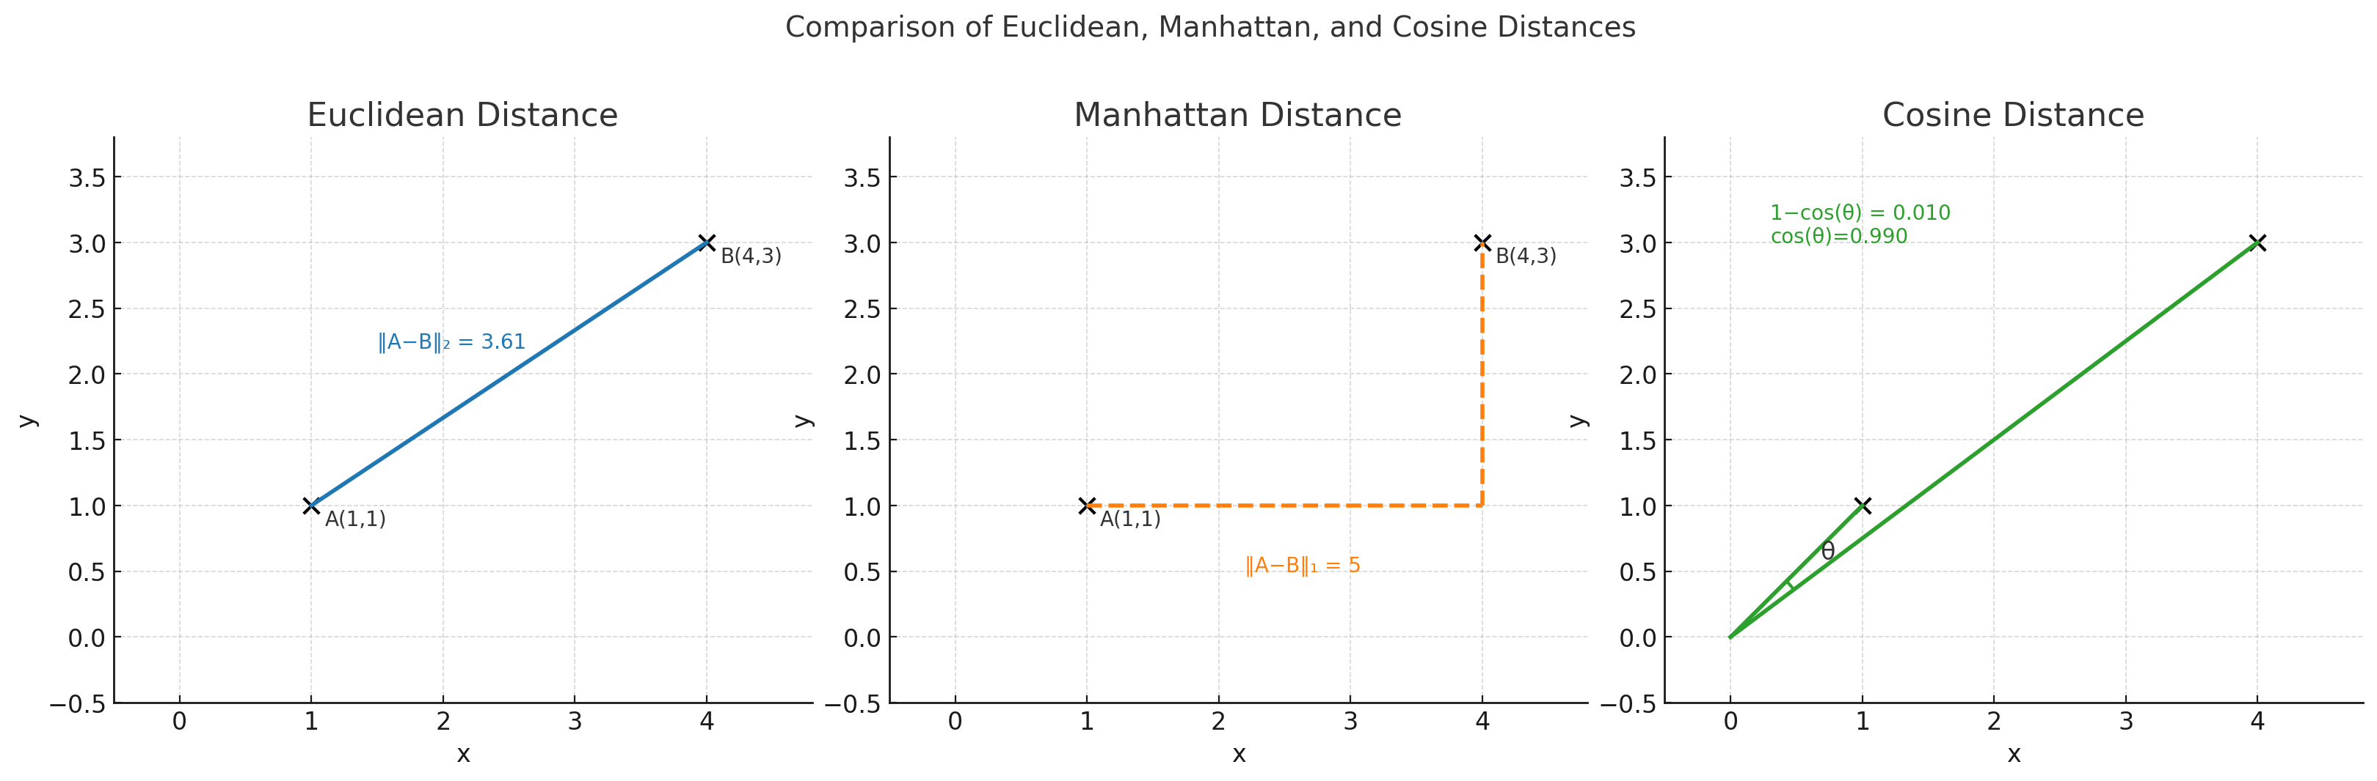
Choice of Distance
Euclidean most common
Cosine often used for high-dimensional data

Slide 8
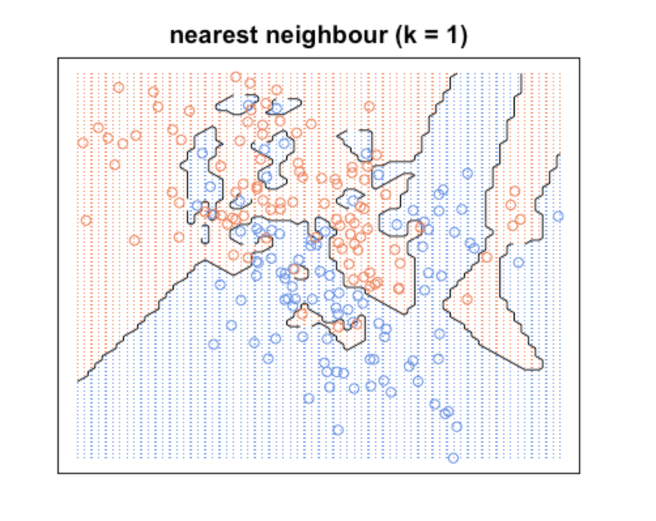
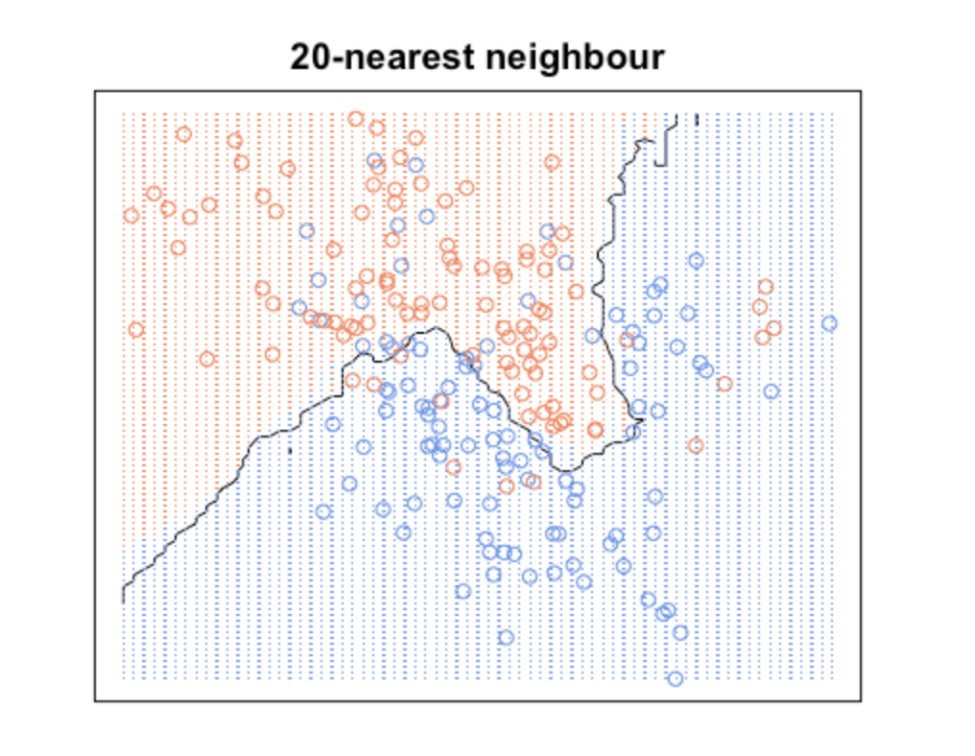
Effect of k on Decision Boundary
https://fderyckel.github.io/machinelearningwithr/knnchapter.html

Slide 9
Decision Trees

Slide 10
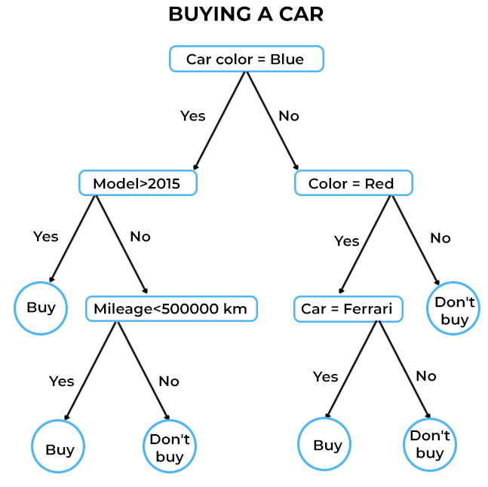
DECISION TREES
Classification and regression tasks.
They are explainable
Can model non-linear relationships
Handles numeric and categorical data
Works with missing data*
No feature scaling required
Prone to data overfitting, instability, bias

Slide 11

DECISION TREES DEFINITIONS
Root Node: All data starts here.
Branch or Sub-Tree: A subset (partition) of the tree.
Splitting: Dividing a node into two or more sub-nodes.
Decision Node: Created by splitting.
Leaf or Terminal Node: Decisions are mad here.
Pruning: Removing a sub-node from the tree is called pruning.
Notes:
Decision Trees are a powerful tool for both classification and regression tasks.
They model data by splitting it based on feature values, creating a tree-like structure where each node represents a decision or split based on a feature.
Decision trees are fast
They are explainable
Easy to learn
Handles missing data easily
Can overfit easily

Slide 12
DECISION TREE HYPERPARAMETERS (Python)
max_depth: The maximum depth of the tree. Limiting this helps prevent overfitting.
min_samples_split: The minimum number of samples required to split an internal node.
min_samples_leaf: The minimum number of samples required to be at a leaf node.
max_features: The number of features to consider when looking for the best split.

Slide 13
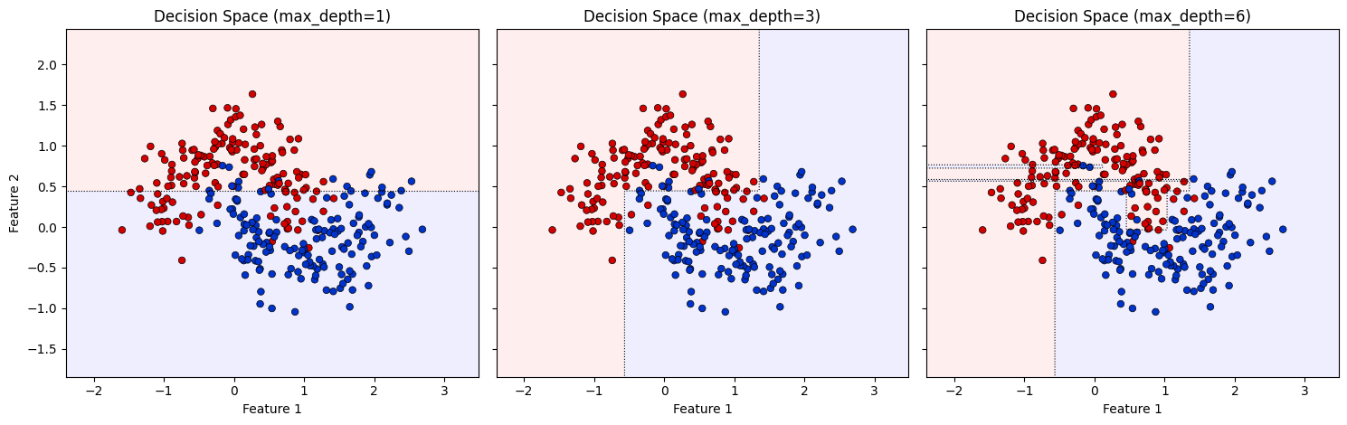
Decision Tree Decision Boundary by Max Depth

Slide 14
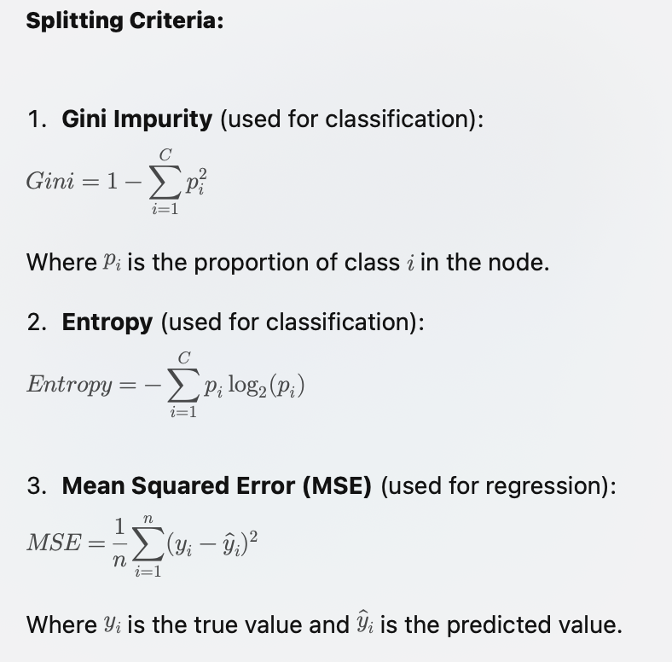
TREE BUILDING PROCESS
1. Start at the root: Evaluate all possible splits based on features.
2. Choose the best split based on a criterion (How to choose best?).
3. Repeat the process recursively until a stopping criterion is met (e.g., max depth, minimum samples per leaf).

Slide 15
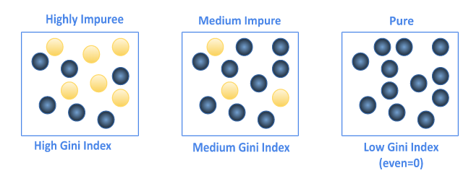
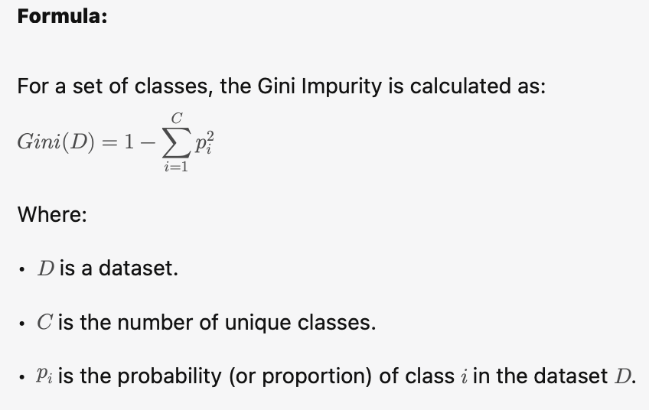
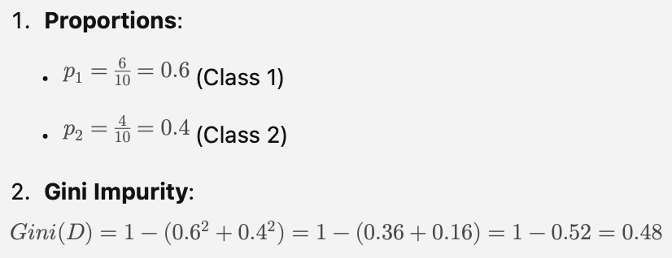
GINI IMPURITY
The Gini Impurity measure quantifies the “impurity” or impurity score of a node.
A lower Gini score means a purer node.
If all data points in a node belong to a single class, the Gini Impurity is 0 (perfect purity).
If the data points are evenly distributed among all classes, the Gini Impurity is at its maximum value (1 – 1/C)
Example Calculation:
Let’s say we have a dataset of 10 samples belonging to two classes: Class 1 (6 samples) and Class 2 (4 samples)

Slide 16
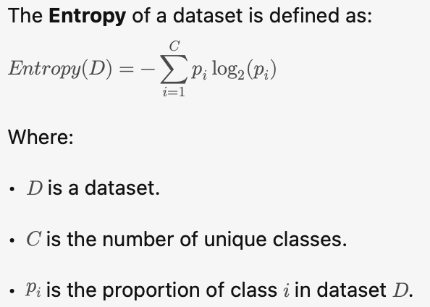
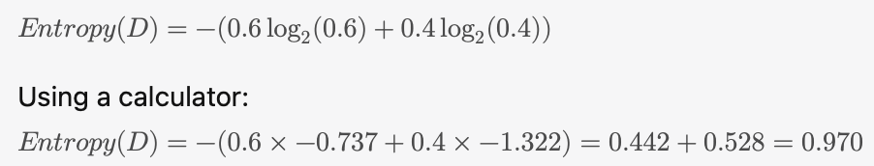
ENTROPY
Entropy is another measure of impurity or disorder, derived from information theory. It is used in decision trees to decide the best split by evaluating how much uncertainty (or entropy) is present in the data.
How to Interpret Entropy:
• If all samples in a node belong to the same class, entropy is 0 (pure node).
• If the samples are evenly distributed among all classes, entropy reaches its maximum, which is log₂(C) (where C is the number of classes).
Example Calculation:
Let’s consider the same dataset of 10 samples with 6 samples of Class 1 and 4 samples of Class 2.
Notes:
Gini Impurity and Entropy are both measures of impurity used to determine the best split in a Decision Tree.
• Gini Impurity is simpler and faster, while Entropy provides more theoretical insight through information gain.
• Both methods aim to reduce the uncertainty (impurity) of the child nodes after a split, and they often lead to similar results.

Slide 17
Entropy vs. Gini Impurity
Gini Impurity
Faster to compute (no logarithms).
Prefers pure splits, leading to shallower trees.
Default in CART (e.g., Scikit-learn).
Entropy
Slower (uses logarithms) but handles rare classes better.
Encourages more balanced splits, sometimes leading to deeper trees.
Used in ID3, C4.5 (Information Gain-based methods).
Key Takeaways:
Use Gini when speed and simplicity matter.
Use Entropy for imbalanced datasets and finer splits.
Differences are usually small in practice.
Notes:
Gini Impurity and Entropy are both measures of impurity used to determine the best split in a Decision Tree.
• Gini Impurity is simpler and faster, while Entropy provides more theoretical insight through information gain.
• Both methods aim to reduce the uncertainty (impurity) of the child nodes after a split, and they often lead to similar results.

Slide 18
Logistic Regression

Slide 19
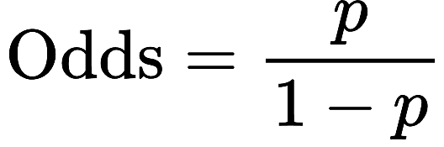
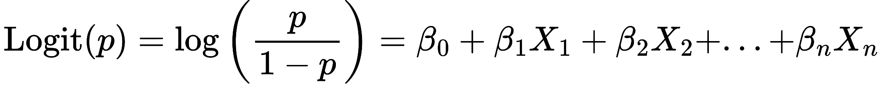
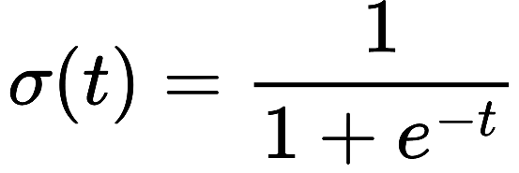
LOGISTIC REGRESSION MATH BACKGROUND
LOGISTIC REGRESSION MATH BACKGROUND
Logistic Regression models the probability that an input belongs to a particular class.
The linear model outputs real-valued numbers.
Predicted values are mapped between 0 and 1.
The logistic (sigmoid) function is defined as:
Odds and Log-Odds:
Odds represent the ratio of the probability of an event occurring to it not occurring:
​
Taking the logarithm of the odds yields the log-odds (logit function):
This linear relationship between log-odds and input features forms the basis of logistic regression.

Slide 20
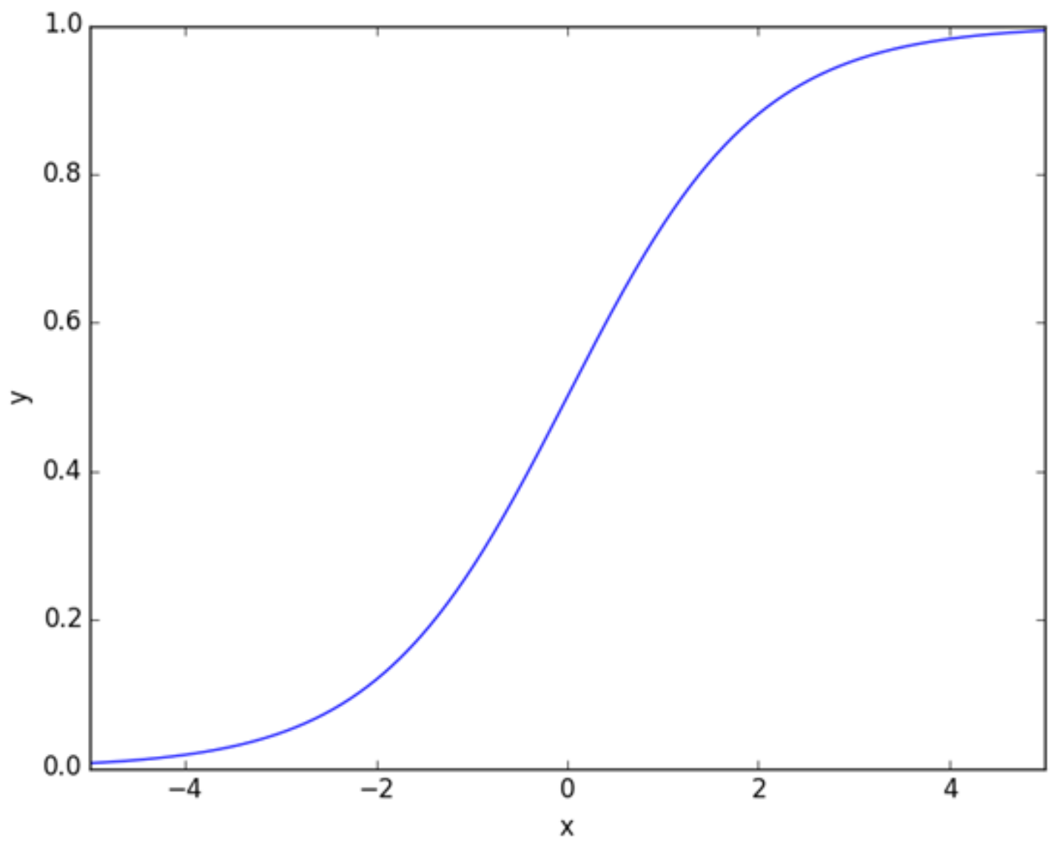
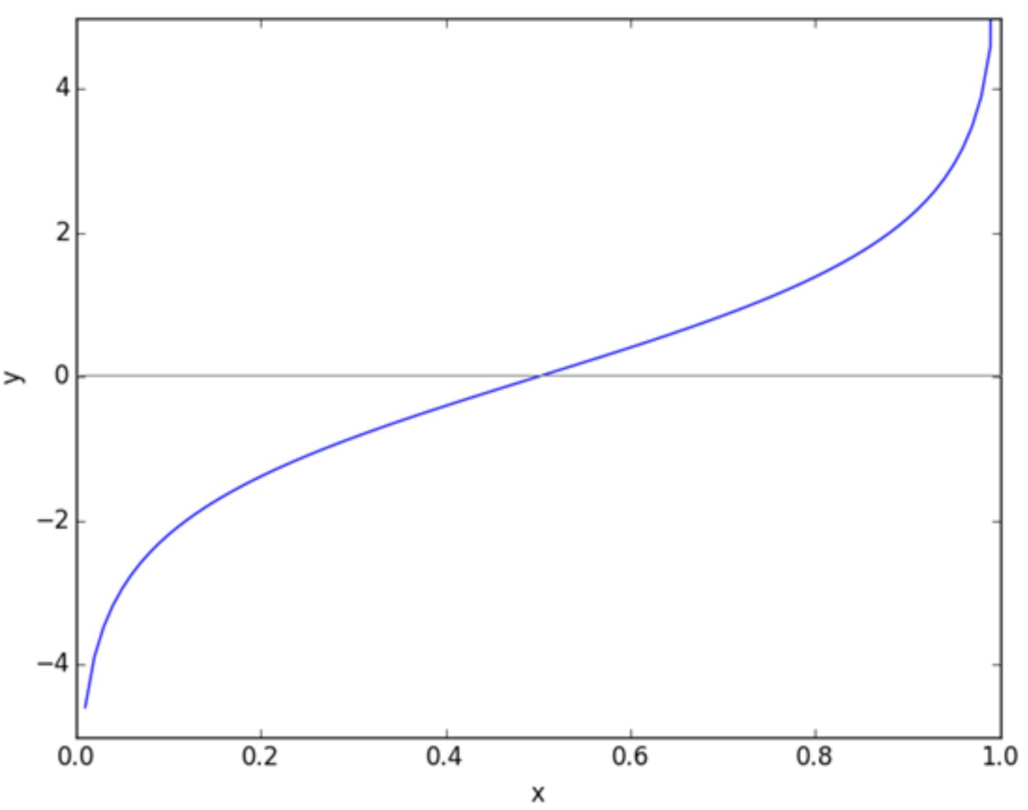
LOGISTIC REGRESSION FUNCTIONS
Sigmoid Function – Number to Probability
Logit Function – Probability to Number

Slide 21
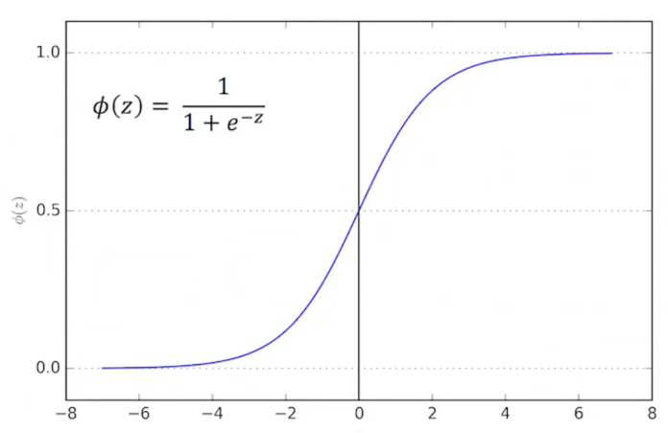
LOGISTIC REGRESSION
Problem Types:
Binary Classification: Predicts one of two possible outcomes (e.g., spam vs. non-spam emails).
Multi-Class Classification: Extended by using techniques like One-vs-Rest or Softmax for handling multiple classes.
Advantages:
Quick: Able to apply to very large datasets
Interpretability: Weights provide insights into feature importance.
Probabilistic Outputs: Predicts probabilities for confidence estimation.
Limitations:
Linearity: Assumes a linear relationship between input features and log-odds of the outcome.
Outliers: Sensitive to outliers; regularization helps mitigate this.
Multicollinearity: Correlated features can reduce interpretability.
Notes:
1. Logistic Regression is a robust, interpretable algorithm for classification.
2. In binary classification, it uses a sigmoid function; for multi-class classification, it uses softmax.
Logistic Regression isn’t suitable when you are trying to predict a continuous output in the traditional sense. In those cases, Linear Regression or other algorithms like Decision Trees for Regression or Random Forests are more appropriate.
Why Not Logistic Regression for Continuous Outcomes?
• Sigmoid Function: The sigmoid function that Logistic Regression uses limits the output to between 0 and 1. For regression problems, you need a model that can output any real-valued number (positive or negative).
• Linear Regression vs Logistic Regression:
• Linear Regression directly predicts a continuous output using a linear relationship.
• Logistic Regression predicts probabilities and uses the output to classify inputs into categories (usually binary).
The term “Logistic Regression” can be confusing because it includes the word “regression”, yet it is primarily used for classification tasks. Here’s the historical context and why it’s called “regression” despite being more commonly associated with classification:
Historical Context:
• Logistic Regression was developed by David R. Cox in the 1950s. Originally, it was designed as a way to model binary outcomes (i.e., two possible outcomes like “yes/no,” “win/lose,” “1/0”).
• The term “regression” in Logistic Regression comes from its statistical roots. In the early days, regression was a broader term used to refer to any method that models the relationship between a dependent variable and one or more independent variables.
• Linear Regression refers to a model where the output is a continuous value, and it uses a linear relationship between input features and output. In contrast, Logistic Regression models the relationship between input features and the probability of a binary outcome, using the logistic function (sigmoid function).

Slide 22
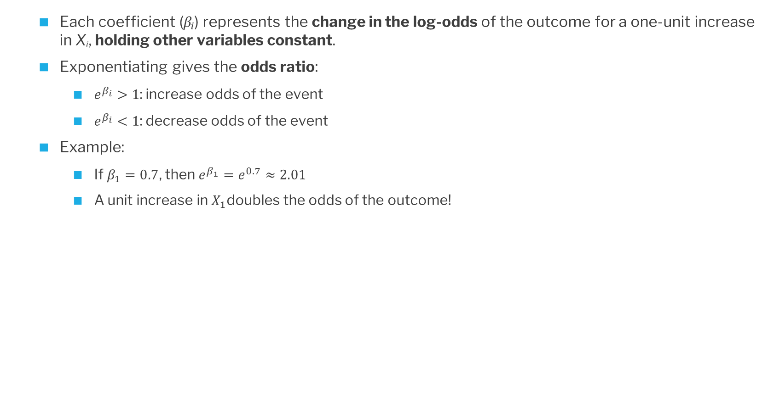
INTERPRETING LOGISTIC REGRESSION COEFFICIENTS
Each coefficient (βᵢ) represents the change in the log-odds of the outcome for a one-unit increase in Xᵢ, holding other variables constant.
Exponentiating gives the odds ratio:
$e^{β_{i}}>1$: increase odds of the event
$e^{β_{i}}<1$: decrease odds of the event
Example:
If $β_{1}=0.7$, then $e^{β_{1}}=e^{0.7}≈2.01$
A unit increase in $X_{1}$doubles the odds of the outcome!
Notes:
1. Logistic Regression is a robust, interpretable algorithm for classification.
2. In binary classification, it uses a sigmoid function; for multi-class classification, it uses softmax.
Logistic Regression isn’t suitable when you are trying to predict a continuous output in the traditional sense. In those cases, Linear Regression or other algorithms like Decision Trees for Regression or Random Forests are more appropriate.
Why Not Logistic Regression for Continuous Outcomes?
• Sigmoid Function: The sigmoid function that Logistic Regression uses limits the output to between 0 and 1. For regression problems, you need a model that can output any real-valued number (positive or negative).
• Linear Regression vs Logistic Regression:
• Linear Regression directly predicts a continuous output using a linear relationship.
• Logistic Regression predicts probabilities and uses the output to classify inputs into categories (usually binary).
The term “Logistic Regression” can be confusing because it includes the word “regression”, yet it is primarily used for classification tasks. Here’s the historical context and why it’s called “regression” despite being more commonly associated with classification:
Historical Context:
• Logistic Regression was developed by David R. Cox in the 1950s. Originally, it was designed as a way to model binary outcomes (i.e., two possible outcomes like “yes/no,” “win/lose,” “1/0”).
• The term “regression” in Logistic Regression comes from its statistical roots. In the early days, regression was a broader term used to refer to any method that models the relationship between a dependent variable and one or more independent variables.
• Linear Regression refers to a model where the output is a continuous value, and it uses a linear relationship between input features and output. In contrast, Logistic Regression models the relationship between input features and the probability of a binary outcome, using the logistic function (sigmoid function).

Slide 23
Support Vector Machine (SVM)

Slide 24

SUPPORT VECTOR MACHINE (SVM)
Core Idea: SVM finds the hyperplane that maximizes the (soft) margin between the closest data points (support vectors) of different classes.
For non-linearly separable data, SVM uses kernel functions to project data into a higher-dimensional space where it becomes linearly separable.
Key Concepts:
• Hyperplane: A decision boundary.
• Margin: Distance between the hyperplane and the nearest data points from either class.
• Kernel Trick: Transforms data into higher dimensions for linear separability. (This is often used for non-linear problems)

Slide 25
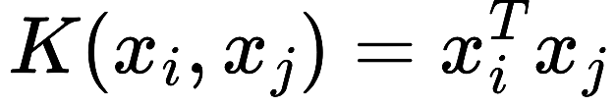
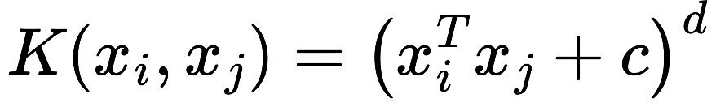
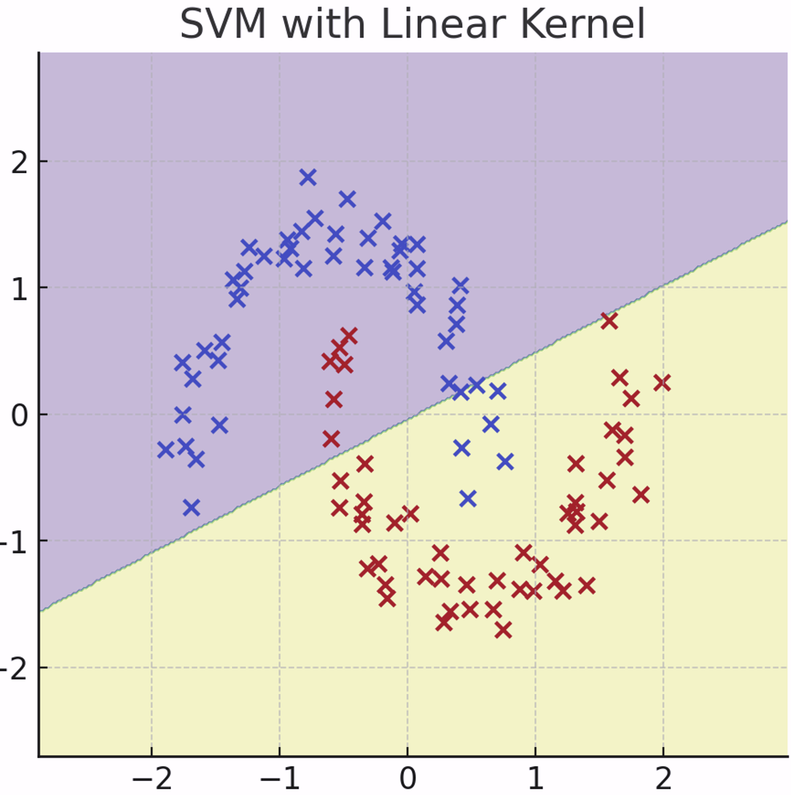
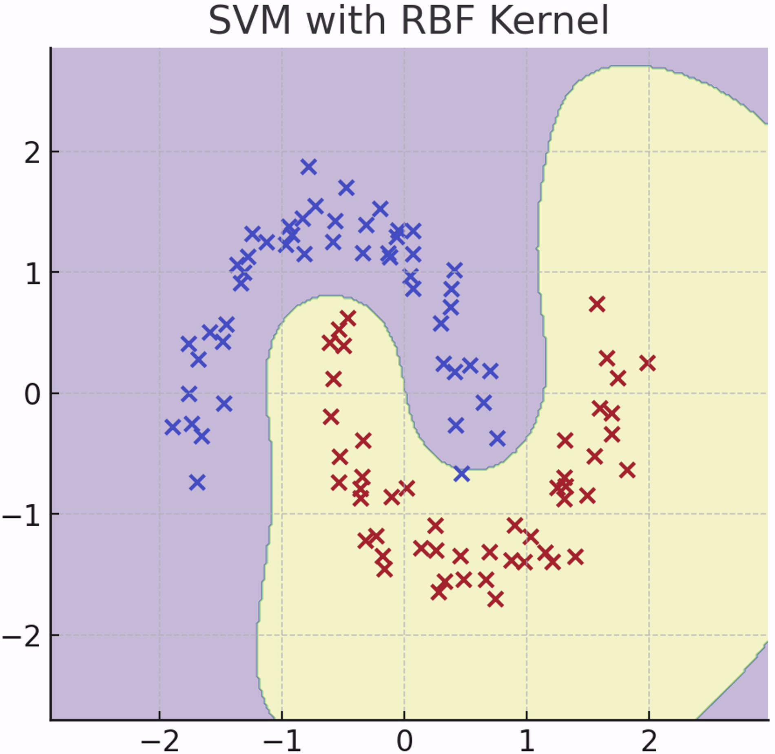
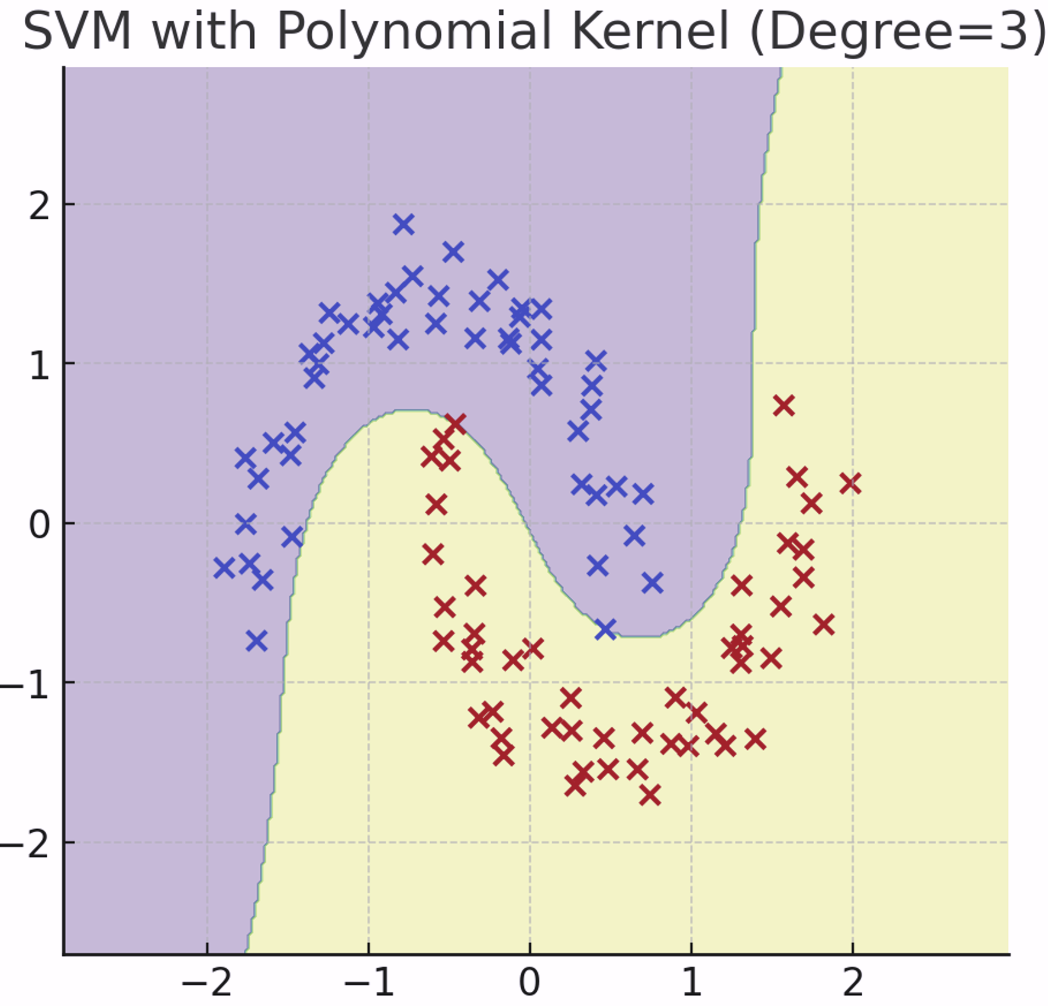
SVM Kernel Functions
Linear Kernel
Radial Basis Function (RBF)
Polynomial Kernel

Slide 26
SVM KEY PARAMETERS
C: Regularization parameter.
High C means the model tries to classify all points correctly (narrow margin), while
Low C allows more misclassifications (wide margin).
Opposite effects of choice of k w/ k-NN
kernel: Defines the type of hyperplane (linear, rbf, poly, etc.).
gamma: Defines the influence of a single training point (applicable for RBF and polynomial kernels).
degree: Degree of the polynomial kernel.
Advantages:
• Effective for high-dimensional data.
• Works well with a clear margin of separation.
Disadvantages:
• Computationally expensive for large datasets.
• Choice of kernel and hyperparameters can be highly problem dependent.

Slide 27
